Slide 1
FACIAL SKIN DISEASES CLASSIFICATION USING DEEP LEARNING
MADHAVAN.P(23MCA0385)

Slide 2

TABLE CONTENT
ABSTRACT
INTRODUCTION
PROBLEM STATEMENT
OBJECTIVES
SCOPE OF THE PROJECT
EXISTING SYSTEM
PROPOSED SYSTEM
SYSTEM ARCHITECTURE
RESULT
CONCLUSTION

Slide 3
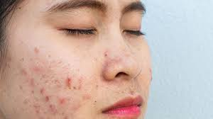
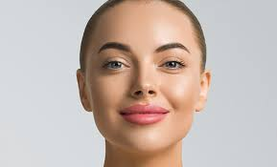
ABSTRACT:
Facial skin diseases pose significant challenges to individuals' health and well-being, impacting their quality of life and requiring effective management strategies. This research introduces a deep learning approach using ResNet50 V2 for the classification of facial skin diseases. Our method leverages a comprehensive dataset and incorporates advanced image processing techniques to improve the accuracy and reliability of disease detection. The study evaluates the performance of ResNet50 V2 in comparison with traditional classification methods. The results indicate that ResNet50 V2 offers superior performance in terms of accuracy, robustness, and efficiency. This approach provides a valuable tool for the early detection and management of facial skin diseases, supporting better patient care and health outcomes.
Keywords: facial skin diseases, ResNet50 V2, deep learning, disease classification, image processing, machine learning, disease detection, accuracy, health management, patient care.

Slide 4
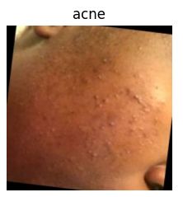
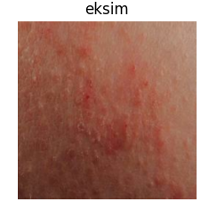
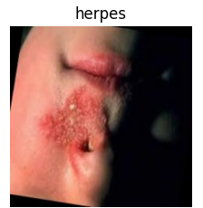
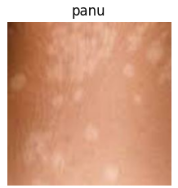
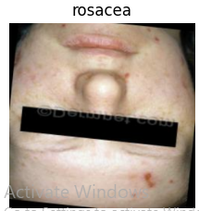
INTRODUCTION:
Facial skin diseases are common health concerns that differ in severity and appearance. These include:
Acne: An inflammatory condition causing pimples and cysts.
Aksim (Actinic Keratosis): Precancerous lesions caused by sun exposure.
Herpes: A viral infection leading to painful blisters.
Panu (Tinea Versicolor): A fungal infection resulting in discolored skin patches.
Rosacea: Redness and visible blood vessels on the face.
Accurately distinguishing these conditions is often challenging. This research leverages the RESNET 50 V2 model to enhance the precision of facial skin disease classification, enabling early detection and improving patient care.

Slide 5

PROBLEM STATEMENT:
Facial skin diseases, such as acne, Aksim (Actinic Keratosis), herpes, panu (Tinea Versicolor), and rosacea, require early and accurate diagnosis for effective treatment.
Traditional diagnostic methods rely on manual examinations, which can be time-consuming, costly, and variable depending on the practitioner’s experience.
Misdiagnosis or delayed diagnosis leads to ineffective treatments and prolonged suffering.
Therefore, there is a pressing need for an efficient, automated system to assist dermatologists in diagnosing facial skin diseases using medical images.

Slide 6

OBJECTIVES:
To classify facial skin diseases using deep learning algorithms, focusing on acne, AKSIM, herpes, panu, and rosacea.
To assess the severity of skin conditions and recommend appropriate treatment measures.
To develop a model capable of analyzing disease patterns and characteristics, providing valuable insights for early detection and management.

Slide 7

SCOPE OF THE PROJECT:
This project involves the development and evaluation of a deep learning model for facial skin disease classification using ResNet50 V2. The scope includes:
Dataset Preparation: Handling and preprocessing a dataset of facial skin images for training and testing.
Model Training: Implementing and training the ResNet50 V2 model on the dataset.
Performance Evaluation: Assessing model performance using various metrics, including accuracy, precision, recall, and F1 score.
Application: Developing a system that integrates the trained model for practical use in disease classification and management.

Slide 8
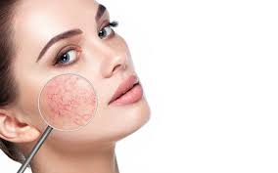
EXISTING SYSTEM:
EXISTING SYSTEM (Base Paper Analysis) The existing system uses a deep learning-based approach combining MobileNet V2 and LSTM for skin disease classification.
MobileNet V2 is lightweight, allowing it to run efficiently on mobile devices, while LSTM helps maintain stateful information for better predictions.
The system uses a grey-level co-occurrence matrix (GLCM) to analyze disease progression.
Tested on the HAM10000 dataset, this model achieved over 85% accuracy and outperformed models like FTNN, CNN, and VGG.
It is computationally efficient, achieving results 2x faster than the conventional MobileNet.
Additionally, a mobile app allows users to diagnose skin diseases instantly by uploading images, assisting both patients and doctors in early detection..

Slide 9

PROPOSED SYSTEM:
The proposed system for facial skin disease classification uses the ResNet50 V2 architecture. The process involves:
Data Collection: Gathering and organizing a diverse dataset of facial skin images.
Data Preprocessing: Applying techniques such as normalization and augmentation to prepare the images for training.
Model Training: Using ResNet50 V2 to train on the preprocessed dataset, incorporating techniques to optimize performance.
Evaluation: Evaluating the model using metrics such as confusion matrix and ROC curve to ensure high accuracy and reliability.

Slide 10
SYSTEM ARCHITECTURE:
Acne
Aksim
INPUT IMAGE
TRAIN MODEL
Facial
Skin Disease Classification
Resnet50 v2
Herpes,
Feature Extraction
Data Preprocessing &Augmentation
Panu
Rosacea

Slide 11
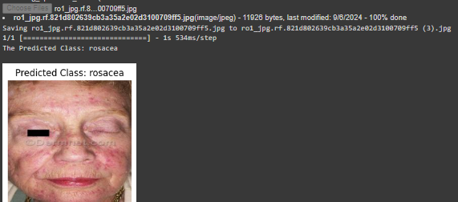
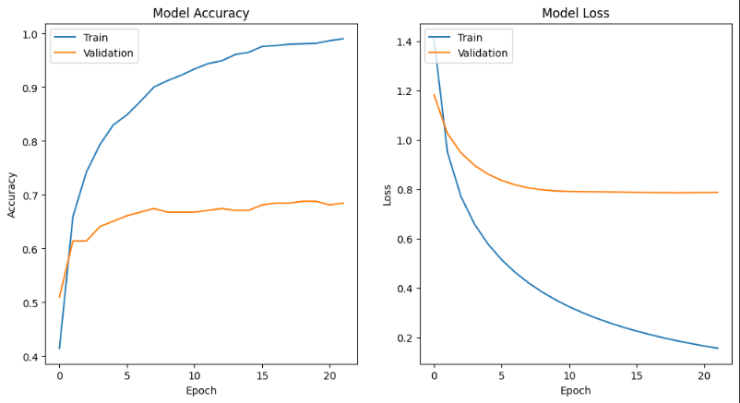
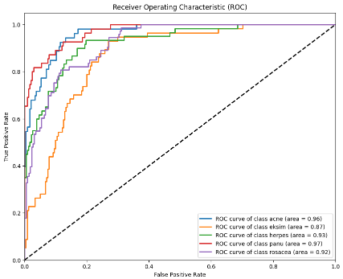
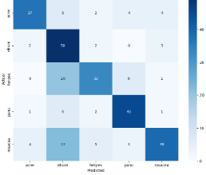
RESULT:
Resnet50v2 reached accuracy:99%
Prediction new data
ROC
Confusion matrics

Slide 12

CONCLUSION:
The developed Facial Skin Disease Classification System using ResNet50V2 achieves high accuracy, surpassing existing models with 99% performance compared to 85% in traditional systems. This approach demonstrates efficiency in diagnosing multiple skin conditions, contributing to early and accurate detection. Future work can focus on expanding the dataset, incorporating more skin diseases, and improving the model's robustness. Additionally, integrating real-time feedback and continuous updates will enhance system adaptability and performance over time.

Slide 13
THANK YOU

